Slide 1


Fundamentals Training
Level 1
Control

Slide 2
Contents
Topics: Slide No:
Process Control Terminology 3 - 10
Control Principles 11 - 18
Basic Control Loop 19 - 23
Advance Control Loop 24 - 31
Control Algorithm 32 - 46
Control System 47 - 54
Exercise 55 - 59

Slide 3
Process Control Terminology
What is a PROCESS ?
Any operation or sequence of operations involving a change in the substance being treated.
Examples:
A change of energy state - hot to cold, liquid to gas
A change of composition - a chemical reaction
A change of dimension - grinding coal
Types of PROCESS VARIABLE:
Pressure Specific Gravity of liquid
Flow Density
Level Mass
Temperature Conductivity
Liquid Interface Composition
Moles

Slide 4
Process Control Terminology
What is a CLOSED LOOP ?
A combination of instruments or functions that are interconnected to measure and control a process variable with feedback.
input
output
PROCESS
FINALCONTROL ELEMENT
A System with Feedback
MEASUREMENT
CONTROLLER

Slide 5
Process Control Terminology
What is a TRANSDUCER
A device that registers a non-electrical parameter (eg. process variable) and outputs a corresponding useable electrical signal.
  Pressure to Capacitance
  Pressure to Resistance or mV
  Temperature to Resistance
  Temperature to mV
Example:
  Capacitance pressure sensor module
  Piezo-resistive pressure sensor module
  RTD
  Thermocouple

Slide 6
Process Control Terminology
What is a TRANSMITTER
A device that will translate the transducers interpretation of the measured variable into a standard transmission signal.
  3 - 15 psi pneumatic signal
  4-20 mA dc electrical signal
  1-5 V dc electrical signal

Slide 7
Process Control Terminology
ADVANTAGE OF 4-20mA CURRENT SIGNAL
Lower installation cost
  simple, twisted pair wiring
Better noise immunity
  current vs. voltage
Insensitive to wire resistance
  current vs. voltage
Better suited for hazardous locations
  intrinsic safety

Slide 8
Process Control Terminology
What is a CONTROLLER ?
Used to keep a process variable at a desired value (set point).
  Closed loop vs. Open loop control
    Difference: Open loop control has no feedback
  Control Modes
    ON/OFF (Binary)
    Proportional (P)
    Proportional-plus-Integral (PI)
    Proportional-plus-Integral-plus-Derivative (PID)

Slide 9
Process Control Terminology
What is a SIGNAL ?
An event that conveys data from one point to another.
What is an INDICATOR ?
An instrument which visually shows the value of the variable.
What is a RECORDER ?
An instrument that makes and displays a continuous graphic, acoustic or magnetic record of a measured variable.
What is a DCS ?
Distributed Control System consisting of functional integrated subsystems. The subsystems are connected by a communication linkage (eg) data bus,data highway.
Notes:
This term does not apply to the internal components of the instrument. (eg) resistor, receiver bellows, etc.
Instruments can account for 2 - 10% of plant hardware.
An instrument will generally by given a Tag. This is a unique set of identifying letters or numbers or both, allocated to each functional element on a Loop.
Loop - comprises of the whole chain from Primary element to Correcting Element.
Typical Signals: Pneumatic, Electric, Hydraulic, Electronic (analog or digital)
3 -15psi capacitance 1 - 2bar 4 - 20mA dc
resistance 1 - 5 v dc
impedance
frequency
This subsystems may be remotely located form each other and connected via communication interface.

Slide 10
Process Control Terminology
What is a FINAL CONTROL ELEMENT?
The last control element in the process control loop that manipulates the process variable.
  Control Valves
    modulates flow rate
    operated by actuator
  Louvers and Dampers
    operated by pneumatic actuators
  Variable Speed Drives
    operated by electronic control signals
      4 - 20 mA
Notes:
Control valves are used to modulate the flow rate. They are operated by an actuator and are continuously throttled for varying the flow. They are very rugged, and may be smaller than the line size.
Control valves are not the only final control element.
Louvers and dampers are often operated by pneumatic cylinders or pneumatic actuators. Positioners are used in many applications.
Variable speed drives typically operate from electronic control signals such as a 4 to 20 mA signal. Variable speed controllers are sometimes used to adjust the throughput of an entire system to match the prevailing loads. By doing so, energy can be conserved by avoiding large pressure drops across the control valves.

Slide 11
Control Principle
1. Measure
2. Compare
3. Adjust
Tasks
Notes:
Three tasks must be performed in order to implement process control:
1. MEASURE the process variable (PV).
2. COMPARE the PV to the setpoint (SP) to determine if an error exists.
3. ADJUST the manipulated variable (MV) to minimize the error.

Slide 12
Control Principle
FEED
PRODUCT
PROCESS
CORRECTING UNIT
MEASURING UNIT
PV
O/P
CONTROLLING UNIT
SP
OPERATOR
Control theory can be encapsulated as the matching of a measured variable (PV) to the plant requirement (SP).
A controller implements a Control Algorithm so that an output signal (O/P) activates a correcting unit. The ratio of output signal (O) to input signals (I) is Gain (K).
1
100
I
Proportional band % = % = x 100%
K
Gain
O
Notes:
The essence of simple automatic control is:
- the state of the process is measured
- this measurement is compared to desired value in a controller
- the controller responds in a pre-defined way to reduce any discrepancy between (i) & (ii)
- a correcting unit translates the controller’s output to alter the state of the process.
Controllers may operate in direct or reverse action and in different modes. If a receiver has feedback, we have a closed loop; otherwise, an open loop.
4 major elements of any feedback control loop are:
Process, Measurement, Final Actuator and Automatic Controller.
(SP-PV)
O/P

Slide 13
Control Principle
Process Variable (PV)
  the actual measurement of the state of the process
Set Point (SP)
  the desired state of the process variable
Control Algorithm
  the predefined response of the controller to PV-SP
Controller Output (O/P)
  a signal determined by the control algorithm
Offset
  the value of PV-SP when the system is in equilibrium
Direct Acting Controllers
  as the value of the measured variable increases, the output of the controller increases.
Reverse Acting Controllers
  as the value of the measured variable increases, the output of the controller decreases.

Slide 14
Control Principle
Inherent Regulation
A plant possesses inherent regulation when, in the absence of a controller, equilibrium is re-established after a disturbance.
  For example, a tank with constant inflow is in equilibrium.
  The outflow valve is then opened a little more.
  The outflow pressure decreases as the tank level falls until inflow again equals outflow.
  Manipulation of the outflow valve result in different, unique equilibrium states.
Notes:
Inherently regulated systems have self-restoring equilibrium states.

Slide 15
Control Principle
Instrument Symbols
Example Instruments
TT
Temperature Transmitter
I/P
Current-to-Pressure
Transducer
FIC
Flow Indicating Controller
PT
Pressure Transmitter
TE
Temperature Element
P/P
Pressure-to-Pressure
(Thermocouple, RTD)
Transducer
Instrument Location
Local
Panel Front
Panel Rear,
Mounting
Mounting
or Rack Mounting
Notes:
In P&ID’s, these symbols are used extensively to note location and function of transmitters, controllers, and other process equipment.

Slide 16
Control Principle
Instrument Symbols
Letter Designations
First Letter
Succeeding Letters
Measured or
Modifier
Readout or
Output
Initiating
Passive
Function
Variable
Function
A
Analysis
Alarm
C
User's Choice
Control
D
User's Choice
Differential
F
Flow Rate
Ratio
(Fraction)
I
Current
Indicate
(Electrical)
L
Level
Light
P
Pressure,
Point (Test
Vacuum
Connection)
Q
Quantity
Integrate,
Totalize
R
Radiation
Record
T
Temperature
Transmit
V
Vibration
Valve, Damper,
Louver
Notes:
The combination of letters and numbers used in P&IDs is used to define instrument function as well as tag number. This means that a instrument tag of PIC-112 is a pressure indicating controller on loop number 112.

Slide 17
Control Principle
Signal Types (ISA)
Connection to Process,
Instrument Supply,
or Direct Mechanical Link
Pneumatic Signal
Electric Signal
Notes:
Signal Types - The ISA Standard also gives guidelines for graphic standards that help to identify signal types, as shown.
The line style used to connect instruments in the P&ID denotes whether there is a direct connection, a pneumatic signal, or an electrical signal connection.
These signal types identify the type of communication.

Slide 18
Control Principle
Controller Types
Pneumatic
Analog
Digital
  Single Loop Controllers
  Distributed Control System
  Fieldbus Control System
Notes:
Controllers are the brains of a control system. Controllers accept two inputs and provide one output signal. One of the inputs is the signal from the transmitter. This signal tells the controller the actual value of the process variable, or simply the PV. The other input is the setpoint and is set by the operator. The setpoint tells the controller the desired value of the process variable. If there is a difference between the PV and the setpoint, an error exists. The controller recognizes the error, and, according to tuning settings on the controller, adjusts the output in order to minimize the error.
The tuning settings tell the controller how much and how fast to change the output when it recognizes an error. The most common type of control is PID, meaning proportional, integral, and derivative actions. These are discussed later in this session.
Controller tuning determines the stability of the control loop.

Slide 19
Basic Control Loop
Pressure Control Loop
I/P
PIC
Pressure Loop Issues:
  May be a Fast Process
    Liquid
    Small Volume
  May Require Fast Equipment
PT
Notes:
Identify the instruments in the diagram.
Considerations:
Speed - Pressure loops may respond to changes in loads and changes in control equipment actions either slowly or quickly. For example:
A large volume gas system (such as a long transmission pipeline or a large gas storage vessel) may respond slowly to changes in loads and control equipment actions.
A small volume liquid system will respond to changes very quickly to changes in loads and control equipment actions.
Some applications, for example compressor bypass or surge control, by their very nature require very fast response of the control equipment.
Equipment Requirements - Fast-acting processes will require instruments and control valves that can react quickly to changes in the process variable.

Slide 20
Basic Control Loop
Temperature Control Loop
Temperature Loop Issues:
  Fluid response slowly to change in input heat
  Requires advanced control strategies
    Feedforward Control
Load Disturbance
TIC
Cold
Water
I/P
TT
Steam
Hot
Water
Notes:
Identify the instruments in the diagram.
Considerations:
Speed - Temperature control systems are typically slow to respond to changes in loads and changes in control equipment either slowly or quickly. The primary reason is that the fluid responds slowly to a change in input heat. Another reason for slow response is that the sensor that is housed in a thermowell and significant time may be required for the measured variable to warm or cool the thermowell. Still more time may be required for the sensor within the thermowell to respond.
Equipment Requirements - Because they are inherently slow, temperature control loops often include advanced control strategies such as feedforward control. Feedforward control will be described later.

Slide 21
Basic Control Loop
Flow Control Loop
Flow Loop Issues:
  May be a Very Fast Process
    “Noise” in Measurement Signal
      May Require Filtering
    May Require Fast-Responding Equipment
  Typically Requires Temperature Compensation
I/P
FIC
FT
TT
Notes:
Identify the instruments in the diagram.
Considerations:
Speed - Flow loops are typically regarded as fast loops; i.e., they generally respond quickly to changes in loads and to changes control equipment actions.
Noise - Flow transmitters are often fast-acting devices in order to keep up with the process. The combination of a fast process and a sensitive transmitter often results in “noise” or “hash” in the control signal. Noise can be thought of as fast, high-frequency oscillations of the control signal.
Equipment Concerns - Flow control systems are often designed with consideration for the following:
To prevent noise from impacting the control equipment, filters are often employed either in the transmitter or in the control system.
Controller tuning and positioner adjustments are typically made to decrease any negative impact of noise and very fast process reactions.
Flow measurement must be compensated to account for the effects of fluid temperature on the fluid density. Accordingly, flow measurement instrumentation commonly includes a temperature measurement input.

Slide 22
Basic Control Loop
Level Control Loop (Inflow)
I/P
LIC
Level Loop Issues:
  Control At Inflow or Outflow
  Non-Self Regulating
LT
Notes:
Identify the instruments in the diagram.
Considerations:
Speed - The speed of repsonse of a level process depends upon vessel geometry and size. Obviously, a small vessell with a narrow diameter will fill and empty more quickly than a large diameter vessel. Speed of the control equipment is not typically a major issue.
Non-Self Regulating Process - Level can be described as a non-self regulating process, or an integrating process.
Inflow or Outflow Control - Control of a level process may take place at the inflow or at the outflow, depending on the requirements and purpose of the application. The primary concern is that the control equipment have the proper action to provide the desired control strategy and fail modes.

Slide 23
Basic Control Loop
Level Control Loop (Outflow)
LIC
I/P
LT
Notes:
The previous slide showed the instrumentation necessary to control the inflow of a process. This slide shows control on the outflow.

Slide 24
Advance Control Loop
What is CASCADE CONTROL ?
Consist of one controller (primary, or master) controlling the variable that is to be kept at a constant value, and a second controller (secondary, or slave) controlling another variable that can cause fluctuations in the first variable. The primary controller positions the set point of the secondary, and it, in turn, manipulates the control valve.
Multi-Variable Control
Primary controller
Secondary controller
r₁
r₂
m
FBC
FBC
Disturbance
c₁
Secondary Process
Primary Process
c₂
Notes:
Involves a master/slave loop combination.
The fast-acting slave receives its set-point from the master.
Disturbance originating within the secondary control loop are corrected by the slave controller before they can influence the controlled variable.
Objective similar to single-loop controller - to achieve balance between supply & demand & maintain the controlled variable at its required constant value.
2 feedback controllers are used but only one process variable (m) is manipulated.
The primary controller maintains the primary variable (c₁) at its set point (r₁) by automatically adjusting (r₂) the set point of the secondary controller.
The secondary controller controls the secondary loop responding to both its set point (r₂) and the secondary measurement (c₂).

Slide 25
Advance Control Loop
Example of CASCADE CONTROL
The temperature of the liquid in the vessel is controlled by regulating the steam pressure in the jacket around the vessel.
Temperature transmitter
Temperature controller
Measurement
IN
Output
Measurement
Pressure controller
Jacket
Pressure transmitter
OUT
Valve
Steam
SINGLE-LOOP CONTROL
Cascade Control Loop
Notes:
Temperature controller provides set point for steam valve or steam-pressure controller.
Such a process involves a long time-constant and a 3-mode controller with long integral time is required. (Single-loop control). This will provide satisfactory control as long as the supply of steam is constant, that is the upstream pressure does not change.
However, if the supply steam is subject to upsets, a different control scheme is needed. The temperature controller will not know the change in heat input (steam pressure) until the temperature of the liquid in the vessel starts to change. Since the time constant of the temperature loop is long, the temperature controller will take a long time to return the process to an equilibrium. Therefore it is desirable to correct for the change in heat input before it affects the temperature of the liquid.
Cascade control system will both control the temperature in the vessel and correct for changes in the supply steam pressure. The steam pressure controller (slave) monitors the jacket inlet steam pressure. Any changes in supply pressure will be quickly corrected for by re-adjusting the valve because this secondary loop has a fast time constant (short integral time). The temperature controller (master) adjusts the set point of the pressure controller as dictated by the heat requirements of the incoming feed.
The time constant of the secondary loop (slave) must be significantly faster than that of the primary loop, or else cascade control will provide no benefits / may cause stability problems.

Slide 26
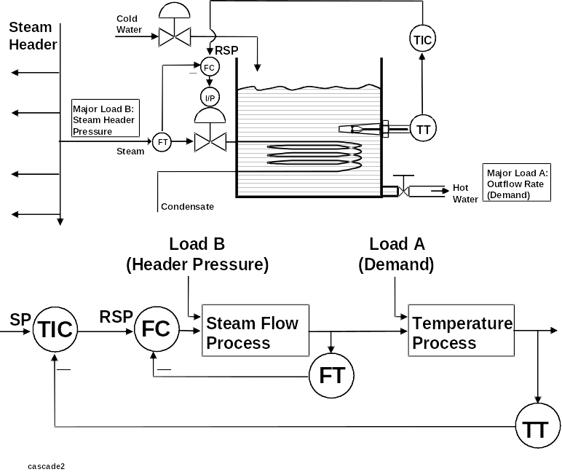
Advance Control Loop
Implementing Cascade Control
Notes:
Identifying Processes - Using a simple temperature loop as an example, the overall process cam be seen as having two processes; a steam flow process and a temperature process, as shown.
Identifying Loads - The major load to the temperature process is the outlow flow rate (demand on the system). The major load to the steam flow process is the pressure in the steam header. If other users in the plant consume more steam, then the header pressure will fall and the steam flow rate to the heat excvhanger will decrease.
Implementing Cascade Control - To implement cascade control, an “inner” feedback loop is included to control the loads that impact the first of the two process. The purpose of the inner loop is to compensate for load changes to the first process so that they do not upset the second process.
Hardware Requirements - The output of the outer loop (the temperature control loop) is used to as the setpoint for the inner loop controller. Therefore, the inner loop controller must have remote setpoint capability; i.e., the setpoint can be set by another instrument instead of by an operator.

Slide 27
Advance Control Loop
What is FEED FORWARD CONTROL ?
Applies to a system in which a balance between supply and demand is achieved by measuring both demand potential and demand load and using this data to govern supply. It gives a smoother and stable control than feedback control.
Multi-Variable Control
Steam
Feedwater
FT
FT
LT
Flow controller
Boiler
Feed forward
SP
PV
O/P
Level indicating controller
SP
Notes:
The output of the loop drives the input.
The objective is to modulate the manipulated variable in response to changing plant load.
Potential application of feedforward technique are virtually endless, but usually used in Distillation Control Process.

Slide 28
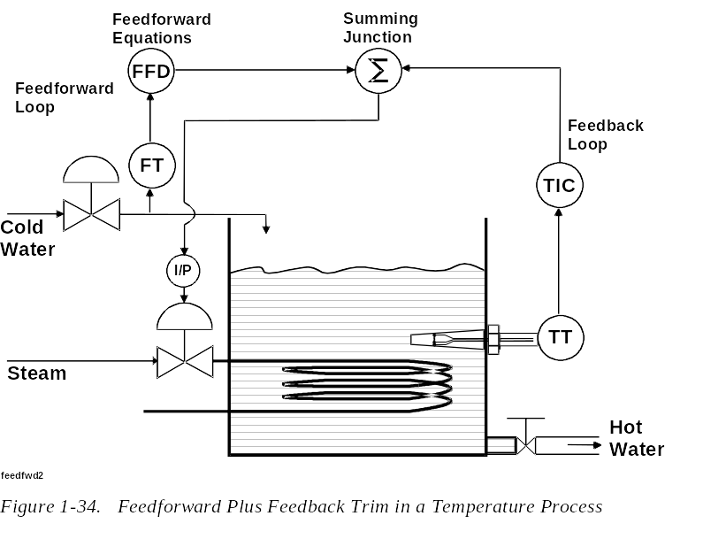
Advance Control Loop
Implementing Feedforward Control
Notes:
Implementing Feedforward Control - The following are required to implement feedforward control:
Mathematical Model. The process engineers that are responsible for system design must construct a mathematical model that describes the relationships between the cold water flow rate, the process variable, and the steam flow rate that is required to keep the PV at setpoint.
Hardware. A feedforward controller and a summing junction must be included in the system.
Feedback Loop. In order to ensure good control, a feedback loop, also known as “feedback trim” is typically included in a feedforward system.

Slide 29
Advance Control Loop
What is RATIO CONTROL ?
An uncontrolled flow determines a second flow so that a desired ratio is maintained between them.
The ratio factor is set by a ratio relay or multiplying unit which would be located between the wild flow transmitter and the flow controller set point. Flow B is controlled in a preset ratio to flow A.
Multi-Variable Control
Controlled flow, B
Controlled flow, B
Wild flow, A
Ratio relay
Output = A x ratio
Remote - set controller
Ratio controller
Wild flow, A
SP
SP
Output
Output
Notes:
Flow transmitter A sense the wild flow. The ratio relay multiplies the output (0 to 100%) of the flow transmitter by a manually set factor :
(Flow A) x (Preset factor) = Output of Ratio relay
This output becomes the Set point of the controller that regulates Flow B. At equilibrium, Flow B equals the set point of the controller, or :
(Flow B) = (Flow A) x (Ratio factor) + Constant
Ratio factor = Flow B / Flow A
BIAS

Slide 30
Advance Control Loop
Example of RATIO CONTROL
Pickling Process
Acid supply
√
Set
Manual water regulator
Measurement
FT
Flow transmitter
FC
Magnetic flowmeter
Water
Flow A
Flow B
Control valve
Pickle tank
Other Application : Fuel/air ratio control system on combustion equipment, e.g. boilers.
Notes:
Ex)
Flow A - range is 0 to 100gpm & Flow B - range is 0 to 100gpm
Output of Transmitters A & B changes linearly from 0 to 100% as the flow changes from 0 to 100%. The ratio relay has a factor adjustment ranging from 0.3:1 to 3:1.
If the ratio factor is set at 1 ( meaning a 1:1 ratio), then Flow B = Flow A
If the ratio factor is set at 2 (meaning a 2:1 ratio), then Flow B = 2 x Flow A
If Flow B - range changed to 0 to 10gpm, a 1:10 ratio is built into the system. In other words, if the ratio factor is 1, then every gallon of A that flows, 0.1 gallon of B will flow.
If transmitters output is proportional to the square of flow, then the ratio will become (2:1)^{½} or (√2:1).
A transmitter with a linear output cannot be used with another with a square root output unless either one is passed thru a converter to obtain a square or square root , as required.

Slide 31
Advance Control Loop
What is SELECTIVE CONTROL ?
The more important condition between two or more candidates is selected. They are used mainly to provide protection to a piece of equipment which could suffer damage as a result of abnormal operating conditions.
Multi-Variable Control
Low select
RS
O/P
O/P
Speed Control
PIC
PIC
O/P
PV
PV
Pump
Notes:
The control output signal is selected from 2 or more signals, usually a safety override.
In the above example;
pump speed is controlled to maintain discharge pressure, providing suction pressure does not get below set point.
Each variable has its own controller. The upstream controller is ‘direct acting’. The output signals are fed to a selector unit which selects either the higher or the lower of the two signals and delivers this to the final control element. The scheme is easily extendable to more than two variables.
Another case is;
Rotary compressors are subjected to damage through “surging” if the delivery flow rate is restricted excessively. Controllers are therefore provided for pressure & flow at the compressor delivery. The final control element could be a control valve which bypasses gas around the compressor.

Slide 32
Control Algorithm
On/Off
Multi-step
Proportional
Integral
Derivative
Notes:
Proportional Control Actions - The proportional action causes a change in controller output only if there is a change in the magnitude of the error (ΔE). In the controller, the proportional action may be referred to as proportional band or proportional gain. When there is a change in error, the proportional action causes a change in the controller output (Δoutput) that is represented as follows:

Slide 33
Control Algorithm
On-Off Control
It is a two-position control, merely a switch arranged to be off (or on as required) when the error is positive and on (or off as required) when the error is negative. Ex.. Oven & Alarm control.
Measured variable
differential
Controller output
Time
Notes:
It is a Two-position control used when the controlled process variables need not be maintained at precise values. It is cheapest type of controller which works best where the system is such that the rates of change of the measured variable with changes of manipulated variable are slow.
(Ex) Domestic Appliances - requiring automatic control:
refrigerators, irons, hot water services and
house furnace.
Which is set at desired temperature. When the house gets cold, the thermostat turns the heater on. When enough heat is supplied to warm the house, the thermostat turns the heater off.

Slide 34
Control Algorithm
Multi-Step Action
A controller action that may initiate more than two positioning of the control valve with respect to the respective predetermined input values.
85
80
Input
75
Time
4
3
2
1
Valve position
Time
Multi-step action
Notes:
(Ex.)
Multi-cylinder compressor
From a measurement of suction or delivery pressure, the multi-position controller engages or disengages the compressor cylinders sequentially until the number of cylinders required to handle the load are in use.
If the load remain steady, then the controller cycles the number of cylinders in use between one below and one above load requirements.

Slide 35
Control Algorithm
Proportional Action (P)
It is the basis for the 3-mode controller. The controller output (O/P) is proportional to the difference between Process Variable (PV) and the Set Point (SP).
Process
Load
SP
PV
Controller
Output
Open-loop response of proportional mode
Notes:
If the other two, integral & derivative are present, they are added to the proportional response.
Proportional means that the % change in the output of the controller is the multiple of the % change in the measurement.
This multiple is called the Gain of the controller.
Proportional Action is adjusted in a controller by adjusting either the
a) gain or
b) proportional band

Slide 36
Control Algorithm
Proportional Action (P)
O/P %
100
The Algorithm is :
- (PV - SP)
θ
O/P
Constant
50
=
+
Proportional Band
(Constant is normally 50% )
S - PV
Tan θ = Gain = 100 / Proportional Band
When a disturbance alters the process away from the set-point, the controller acts to restore initial conditions. In equilibrium, offset (PV-SP = constant) results.
PV
Many controllers have a ‘manual reset’. This enables the operators to manipulate the ‘constant’ term of the algorithm to eliminate offset.
Time
Recovery time
Offset
SP
Time
Notes:
The acceptability of proportional-only control depends on whether this offset can be tolerated. Since the error necessary to produce any output decreases with the proportional band, the narrower the proportional band, the less the offset. For large capacity, small dead time applications accepting a very narrow proportional band, proportional-only control will probably be satisfactory, since the measurement will remain within a small % band around the set point.

Slide 37
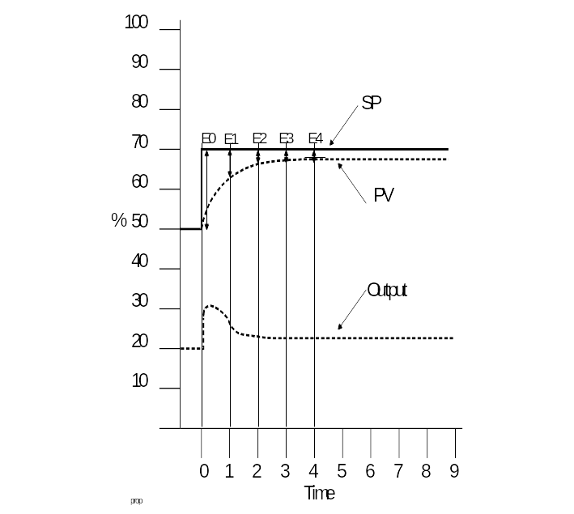
Control Algorithm
Low Proportional Gain: (Closed Loop)
Notes:
Low Gain Scenario - First, consider a closed loop example in which the P Gain is set to a relatively low value.
At Time 0, an error (E0) is introduced by abruptly changing the setpoint. The change in setpoint represents a large change (increase) in error; therefore, the proportional action makes a proportional change (increase) in the output.
In response to the change in output, the PV begins to move towards the SP; therefore, the error becomes smaller. At Time 1, the error (E1) has decreased substantially from the error at Time 0; therefore, the proportional action has caused the output to decrease in proportion to the decrease in error.
At Time 2, the change (decrease) in error has also resulted in a decrease in output.
At all times beyond Time 2, the changes in error are very small (there is little difference between E2, E3, E4, etc.). And, because a low value of P Gain has been set, the proportional action has virtually no response to the very small changes in error. As a result, the proportional action has no affect on the output at times beyond Time 2. In essence, the proportional action stops having an affect on the output before the PV reaches the SP.

Slide 38
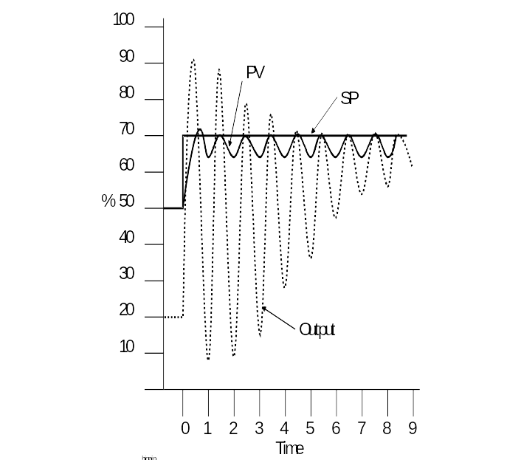
Control Algorithm
High Proportional Gain: (Closed Loop)
Notes:
High Gain Scenario - In an effort to eliminate error, the value of P Gain may be set to a higher value as shown. If the gain is too high, the loop will become unstable; that is, the output will swing wildly between extremes and the PV will cycle. This situation is to be avoided because of excessive wear on the control valve and because of the poor control (rapid fluctuations in the PV).
Proportional Tuning - To avoid instability, the P Gain is often initially set a fairly low value; e.g., some operators begin with a value of 0.2. Through trial and error or other tuning methods, the value of P Gain may be increased to achieve an acceptable balance of responsiveness and stability.

Slide 39
Control Algorithm
Integral Action (I)
Whilst PV ≠ SP, the controller operates to restore equality.
As long as the measurement remains at the set point, there is no change in the output due to the integral mode in the controller.
The output of the controller changes at a rate proportional to the offset. The integral time gives indication of the strength of this action. It is the time taken for integral action to counter the ‘offset’ induced by Proportional Action alone.
% Measurement
Set Point
Set Point
R_{T}
R_{T} = Reset Time min./rpt
a {
% Output
b {
a=b
Open-loop response
Time
Time
Integral mode
Proportional plus Integral mode
Notes:
If it is essential that there be no steady state difference between measurement and set point under all load conditions, an additional function must be added to the controller. This function is called Integral Action (an older term is Reset).
The controller output is the progressive summation of the individual (SP-PV) differences each time the system is sampled (T_{S}). This sampling/output cycles - ‘repeats per minute’.

Slide 40
Control Algorithm
Integral Action: (Closed Loop)
100
90
80
SP
70
60
PV
%
50
40
Proportional
Plus Integral
30
Output
20
10
Proportional
Response
0
1
2
3
4
5
6
7
8
9
Time
Notes:
In a closed loop, the integral action can be viewed as an extension or amplification of the proportional action; i.e., the controller output continues to respond to error as long as an error is present.
For many processes, the combination of the proportional and the integral actions provides very good control in terms of speed and stability. However, the integral action makes controller tuning a bit more difficult; if set to a value that is too high (too fast), the integral action can cause system instability.
Integral Tuning - To avoid instability, the I Gain value is often initially set fairly low. Through trial and error or other tuning methods, the value of I Gain may be increased to achieve an acceptable balance of responsiveness and stability. In general, a fast process requires a faster integral setting and a slow process requires a slower integral setting.

Slide 41
Control Algorithm
Derivative Action (D)
As the PV changes, the controller resists the change.
The controllers output is proportional to the rate at which the difference between the measured and desired value changes.
The derivative time is an indication of this action. It is the time that the open-loop P+D response is ahead of the response due to P only.
% Measurement
Set Point
Set Point
D_{T} = Derivative Time (min)
D_{T}
% Output (I/D)
Proportional only
Open-loop response
Time
Time
Proportional + Derivative
Derivative mode
Proportional plus Derivative mode
Notes:
Derivative Control - sometimes known as Rate Control.
Proportional mode - responds to the size of the error
Integral mode - responds to the size & time duration of the error
Derivative mode - responds to how quickly the error is changing
It shortens the time taken to reach offset.
If a measurement (PV) is changing at a constant rate, then the derivative output is proportional to the rate of change of this error.
The greater the rate of change the greater the output due to derivative response.
Changes in errors result due to a) changes in set point
b) changes in measurement
c) or both the above
Most modern controllers apply derivative action only to changes in the measurement to avoid large output spike caused by step changes in set point.
Derivative action in controllers helps to control processes with especially large time constant.
Derivative action is unnecessary on processes that respond fairly quickly to valve motion, and cannot be used at all on process with noise in the measurement signal such as flow.

Slide 42
Control Algorithm
PID Action: (Closed Loop)
100
90
80
SP
70
60
PV
PID Output
%
50
40
30
20
10
0
1
2
3
4
5
6
7
8
9
Time
Notes:
Closed Loop Response - This shows the effects of PID control in a closed loop. The initial response of the derivative action is to increase the output to its maximum value. (Because the change in the rate of error is a vertical line, or an infinite slope, the controller output should also be infinite. Of course, the controller output is limited to its maximum value.) Each time the P and I actions cause the PV to increase or decrease, the derivative action again reacts to the change in the rate of change in the error and introduces additional large changes in the output.
In the example that is shown, excessive gain is causing cycling of the control valve and cycling of the PV. This is a common occurrence when the derivative action is applied when it should not be, or when its gain value is improperly configured.
Derivative Tuning - For the majority of pressure, flow, and level applications, the derivative action is disabled; i.e., the value of D Gain is set to 0. Unless the user is knowledgeable of the process and is experienced in controller tuning, the derivative should be used with caution.

Slide 43
Control Algorithm
PID Control
80
Measurement
60
% Scale Range
40
A
20
Proportional
Proportional + Integral
Controller Output
or
Valve Position
B
Proportional + Integral + Derivative
Time - minutes
Open-loop response of three-mode controller

Slide 44
Control Algorithm
P & ID Piping & Instrumentation Drawing
Compressed Air Pipe
Converter
I/P
PID
Controller
PIC
Pneumatic
Control
Valve
PT
Pressure
Transmitter
P
Process Vessel
Fluid Pump
Notes:
ISA Symbology - The Instrument Society of America (ISA) published and endorses a set of graphics symbols that are used to create graphic representations of process control systems, or P&ID’s (Piping and Instrumentation Drawings). The ISA symbols for commonly used control instruments are shown. It is common for individual plants and companies to use symbols that vary somewhat from the ISA guidelines.
For more information:
A complete description of all the graphic symbols for process control is included in ISA Standard S5.1 Instrumentation Symbols and Identification.
Also note:
There is a difference between PID (Proportional, Integral, and Derivative) and P&ID (Piping and Instrumentation Drawings).

Slide 45
Control Algorithm
Controller Selection
Start
✶
Step change in valve travel
Use
PID
Yes
Can offset be tolerated ?
Use
P-only
No
✴
Reaction curve of measured variable
63.2%
Yes
Is dead time excessive ?
No
Is noise present ?
Yes
Use
P+I
C
Capacity
Dead Time
No
Time (sec)
Notes:
T_{A}
T_{B}
Is T_{A} > T_{B} ?

Slide 46
Control Algorithm
Controller Adjustment
Period
P-only
PID
Controlled Variable
PI
Time
Control loop Proportional band Time constant Derivative
Flow High (250%) Fast (1 to 15 sec) Never
Level Low Capacity dependent Rarely
Temperature Low Capacity dependent Usually
Analytical High Usually slow Sometimes
Pressure Low Usually fast Sometimes

Slide 47
Control System
Adaptive Control
An automatic control scheme in which the controller is programmed to evaluate its own effectiveness and modify its own control parameters to respond to dynamic conditions occurring in or to the process which affect the controlled variables.
Ex) Digital Controller
- Sensors are run to the computer’s input.
- Servomechanisms are connected to the computer’s output.
- Future changes don’t require re-wiring.
- Changing control functions (P,I, and D) and configurations (between cascade mode and feedforward mode) will be made on the computer’s program and not necessarily to any hardware.
Notes:
In practice, fixed constant is not always the best arrangement to maintain good control under changing plant conditions.
The constants such as;
Proportional Band, Integral Time and Derivative Time
should be “tuned” during plant commissioning to give optimum controller response.
Adaptive control means adapting tuning constants to suit current operating condition.
If the proportional band, integral time & derivative time are maintained as fixed constant, then the control is NOT Adaptive.
The digital computer is so flexible in this regard that the control strategies can be changed by the computer program itself.

Slide 48
Control System
Supervisory Control
A control strategy where the process control computer performs system control calculations and provides its output to the setpoints inputs of conventional analog controllers. These analog controllers actually control the process actuators, not the main-control computer.
S
⇒SP₁
Controller
A
Supervisory Control
M.I.S
S
⇒SP₂
Controller
A
S
⇒SP₃
Controller
A
Notes:
Centralised control - Computer control - digital computer control (Adaptive control) - Supervisory control - distributed control.
The above scenario, purely digital devices (incorporating the basic PID algorithm is either sensor or actuator as appropriate) will handle the basic loop operation.
Supervisory control capability will access the loops across a LAN using a Fieldbus protocol.
The supervisory control will be able to perform 3 key tasks:
(i) higher order control strategies
(ii) changing the loop tuning parameters
(iii) acting as sink and pass-through of information

Slide 49

Control System
Today’s DCS System
Coax
I/O Rack
Controller
Tools for Process
Analysis, Diagnostics.
HW and
Software
Filtering
Sampled
Value
Measurement
I/O Rack
Controller
Tools for Process
Analysis, Diagnostics.

Slide 50
Control System
What is a FIELDBUS ?
Definition...
A digital, two-way, multi-drop communication link among intelligent field devices and automation systems.
Fieldbus
(Only Digital Signals)
P
T
Control room
operator stations
L
Control systems
(DCS or PLC)
F
Notes:
3
General Notes:

Slide 51

Control System
Fieldbus Control System
Work Systems
Total of approximately 35,000 devices
(due to address limits) .
Gateway
HSE
Controller
124
H2
Bridge
H1
Devices
H1
H1
H1
H1
32 Devices
H1 - 31.25 Kbit/s
HSE - 100 M bit/s
(Fast Ethernet)
H1
32
Devices
Notes:
33
Main Point: Discuss current control system architectures

Slide 52
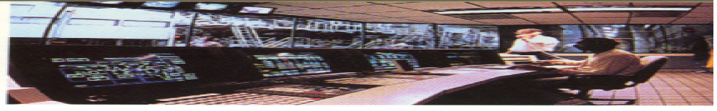
Control System
Proprietary Bus
ADVANCED CONTROL
OPTIMIZATION
PID
PID
AI
AI
AO
DCS
4 -20 mA
4 -20 mA
4 -20 mA
Control in the control room

Slide 53

Control System
Foundation Fieldbus Devices
Delta V
Built-In
Function Blocks
Control Anywhere
Valve
Transmitter
BKCAL_IN
BKCAL_OUT
FIELDVUE
OUT
IN
OUT
CAS_IN
AI
PID
AO
Control in the field with fieldbus

Slide 54

Look at how the CONTROL migrate
Central Control Loop
Local Control Loop
Control in the field
DCS
FCS
DDC
Digital
PID
PID
Digital
Analog
Analog
PID
PID
Loop 1
Loop 2
Loop 1
Loop 2
Loop 1
Loop 2
Control in the device itself

Slide 55
Exercise
Which defined term is closest to the description or encompasses the example given?
A. Controller F. Primary element
B. Converter G. Signal
C. Instrument H. Transducer
D. Point of measurement I. Transmitter
E. Process
1. Process temperature increases the measurable
resistance in a monitored electrical circuit. [ ]
2. Pulsed output from a turbine meter. [ ]
3. Heat-injected plastic molding. [ ]
Notes:
1) Transducer
2) Signal
3) Process
4) Transmitter / Instrument
5) Controller

Slide 56
Exercise
4. Temperature transmitter. [ ]
5. Device which adjusts the measured value of the
process to the requirements of the operator. [ ]
6. Element, flow transmitter, controller and correcting unit. [ ]
7. A pipe piece is tapped for a sample fluid. [ ]
8. A device changes an industry standard pneumatic signal to an industry standard hydraulic signal. [ ]
Notes:
6) Instrument
7) Loop
8) Point of measurement
9) Converter
10) Primary element

Slide 57
Exercise
9. Identify the components indicated by the Arrows.
Notes:
PRIMARY ELEMENT
PROCESS FLUID
TRANSDUCER
TRANSMITTER
SIGNAL
INDICATOR
RECORDER
CONTROLLER
CONVERTER
ACTUATOR
CORRECTING ELEMENT

Slide 58
Exercise
Which defined term is closest to the description or encompasses the example given.
A. Cascade control F. Gain
B. Control algorithm G. Offset
C. Control valve H. Proprietary Bus
D. Feed-forward control I. Smart Device
E. Foundation Fieldbus
10. The predefined response of the controller to PV-SP. [ ]
11. The value of PV-SP when the system is in equilibrium. [ ]
12. The ratio of controller’s output to input. [ ]
13. It is a final control element operated by an actuator. [ ]
Notes:
10. C
11. I
12. F
13. C

Slide 59
Exercise
14. Involves master & slave controllers. [ ]
15. The output of the loop drives the input. [ ]
16. A digital communication based control network
with control action in the controller only. [ ]
17. A digital communication based control network that
allow control in the field. [ ]
18. A device that provide both analog & communication
signal in its loop wire pair. [ ]
Notes:
14. A
15. D
16. H
17. E
18. I

